Slide 1
Process and Thread Synchronisation Concepts
Lecture 3 of 4
Mutual Exclusion
Semaphores, Mutexes, Monitors
Producer/Consumer Problems
Events, Conditions and Rendezvous.
Note: Examples of the concepts presented here can be found in the RTExamples folder: Q9
You are encouraged to open the project(s) in Visual Studio and run the program(s)
©Paul Davies 2020. Not to be copied, used, or revised without explicit written permission from the copyright owner. This lecture may contain animations and is best viewed as a slide show

Slide 2
Semaphores as General Synchronisation Tools
We saw in the last lecture that a binary semaphore can be used to enforce mutual exclusion on a non-sharable resource, e.g. a datapool.
Processes or threads perform Wait() and Signal() operations on the semaphore to “Lock” a resource for sole use and then “Unlock” it when they have finished.
Although this demonstrates one application of a semaphore, their use is more general than that, as they can be used to solve a variety of synchronisation problems in concurrent systems. i.e. coordinate actions so that things happen in the right order, at the right time, and the right number of times.
Let's take a look at a classical synchronisation problem and then at the end look at how semaphores can be used to solve more general problems.

Slide 3
Classical Synchronisation : The Producer-Consumer Problem
Consider the arrangement of threads P1 and C1 shown below
  P1 is a Producer thread that produces/generates data for data pool DP1.
  C1 is a Consumer thread that consumes/reads data from the pool DP1 whenever such data is produced.
Producer/Consumer problems arise frequently in concurrent systems and within OS’s, e.g. pipelines, networks, print spoolers as well as in user generated programs, e.g. a thread produces data that another thread is waiting for etc.
The CPipeline class in the RT library is based around a producer consumer problem described here. After you have read this lecture, take a look and see if you can follow it.
Data Pool DP1
P1
C1
Produce
Consume

Slide 4
Problems in a Producer Consumer Arrangement
Because P1 and C1 are ‘unaware’ of each others actions and go about their business independently of each other at their own speeds, there are two problems associated with simply letting these threads carry on producing and consuming data in their own time at their own speed without regard for each other.
Problem 1 - Data Corruption.
Thread P1 might update DP1 at the same time that C1 attempts to read it.
If this happens, there is a risk that C1 could read inconsistent data, that is, a mixture of data from a previous update and one currently in progress.
In essence we have a Mutual Exclusion problem to solve where we must make sure that only one thread is accessing DP1 at any point in time.
Data Pool DP1
P1
C1
Produce
Consume

Slide 5
Problem 2 - Thread Synchronisation.
Threads P1 and C1 are not synchronised to each other. C1 does not know when P1 has updated the datapool (and can thus read it safely).
Similarly, P1 does not know when C1 has read the most recent data from the datapool (and thus it is safe to overwrite it).
Because of this lack of synchronisation
  P1 might generate data faster than C1 can consume it, resulting in overwritten or lost data.
  C1 might read data faster that P1 can produce it. C1 will not know if it is reading new data or the same data over and over again.
while(1) {
Produce Data;
Store in Data Pool;
}
while(1) {
Consume Data in Data Pool;
Save data locally;
}
Data Pool DP1
P1
C1
Produce
Consume

Slide 6
In effect, neither thread knows what the other one is doing.
To overcome this problem, we need to introduce a mechanism that will:-
  Prevents one thread from reading while the other is writing.
  Allow both threads to Synchronise their actions so that the consumer thread waits for new data to be produced, and the producer thread waits for any previous data to be consumed.
while(1) {
Produce Data;
Store in Data Pool;
}
while(1) {
Consume Data in Data Pool;
Save data locally;
}
Synchronisation and M.Exclusion required
Data Pool DP1
P1
C1
Produce
Consume

Slide 7
Solving the Producer Consumer Problem
The solution to the producer consumer problem requires two semaphores,
  PS1 (a "producer" semaphore, created with an initial value = 0)
  CS1 (a "consumer" semaphore, created with an initial value = 1)
The producer thread signals PS1 when new data is produced.
The consumer thread waits on PS1 for the production of new data.
The consumer thread signals CS1 when new data has been consumed.
The producer thread waits on CS1 the previous data to have been consumed.
PS1=0
PS1.Signal()
PS1.Wait()
Data Pool DP1
P1
C1
Produce
Consume
while( need to produce ) {
CS1.Wait( )
ProduceData( )
PS1.Signal( )
}
CS1.Wait()
CS1.Signal()
while( need to consume ) {
PS1.Wait( )
ConsumeData( )
CS1.Signal( )
}
CS1=1

Slide 8
The Producer and Consumer Thread Operation
First let's start off by examining the Pseudo-code for each thread's solution to show how each interacts with these semaphores.
Producer Thread P1 Consumer Thread C1
while( need to produce ) { while( need to consume ) {
CS1.Wait( ); PS1.Wait( );
ProduceData( ); ConsumeData( );
PS1.Signal( ); CS1.Signal( );
} }
Notice how each thread performs Wait() and Signal() on opposite semaphores.
The Producer thread P1 performs a Wait() on CS1, but a Signal() on PS1.
The Consumer thread C1 performs a Wait() on PS1, but a Signal() on CS1.
Note also how each thread performs Wait()/Signal() on the opposite semaphore to the other thread, i.e. P1 performs a Wait() on CS1, while C1 performs a Signal() on CS1.

Slide 9
Operation – Assume Producer produces before Consumer consumes
The producer thread must be allowed to produce one item of data and store it in the datapool, but after that it must wait for the consumer thread to consume that data before producing more. In other words the producer thread has to synchronise itself to the operation of the consumer thread.
Let’s see if that is achieved.
PS1=0
1
PS1.Signal()
Data Pool DP1
P1
C1
Produce
while( need to produce ) {
CS1.Wait( )
ProduceData( )
PS1.Signal( )
}
CS1.Wait()
CS1=1
0
Blocked after 1 produce

Slide 10
Operation – Assume Consumer consumes before Producer produces
We must ensure that the consumer thread waits until an item of data has been produced before it attempts to consume anything, thus the consumer thread needs to synchronise itself to the operation of the producer thread.
Let’s see if that is achieved.
Blocked as nothing to consume
PS1=0
PS1.Wait()
Data Pool DP1
P1
C1
while( need to consume ) {
PS1.Wait( )
ConsumeData( )
CS1.Signal( )
}
CS1=1

Slide 11
Operation – Assume Producer and Consumer working together
Let’s assume that the consumer is currently blocked waiting for the producer, can they synchronise themselves?
C1 Blocked as nothing to consume (PS1 = 0)
C1 Woken up by Signal() on PS1
PS1=0
PS1.Signal()
PS1.Wait()
Data Pool DP1
P1
C1
Produce
Consume
while( need to produce ) {
CS1.Wait( )
ProduceData( )
PS1.Signal( )
}
while( need to consume ) {
PS1.Wait( )
ConsumeData( )
CS1.Signal( )
}
CS1.Wait()
CS1.Signal()
CS1=1
0
P1 Woken up by Signal() on CS1
P1 Blocked as CS1 = 0

Slide 12
Operation (cont…)
The Signal() operation performed on PS1 and CS1 by Producer and Consumer threads acts a like wakeup call as shown below, preventing one thread from getting ahead of the other in terms of the production or consumption of data
Producer thread P1 Consumer thread C1
while( need to produce ) { while( need to consume ) {
CS1.Wait( ) PS1.Wait( )
ProduceData( ) ConsumeData( )
PS1.Signal( ) CS1.Signal( )
} }
Signals act as Wake up calls to those threads waiting on the Semaphore

Slide 13
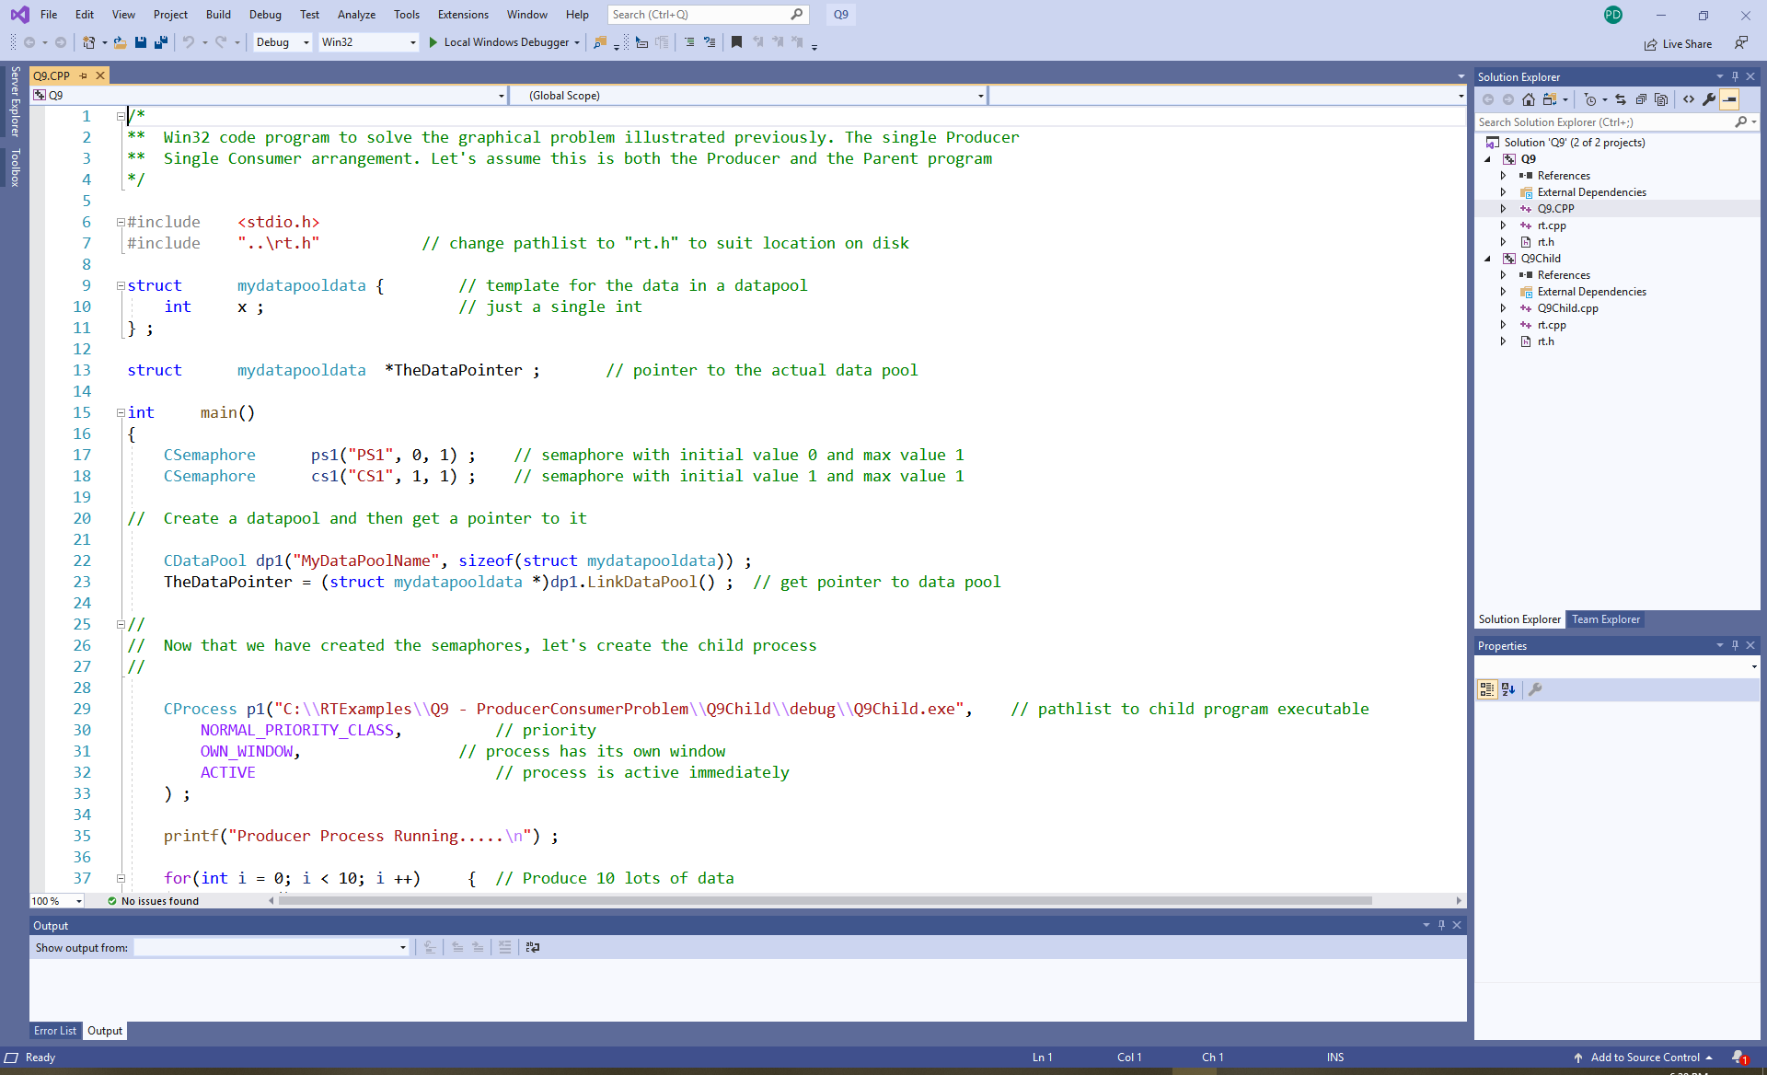
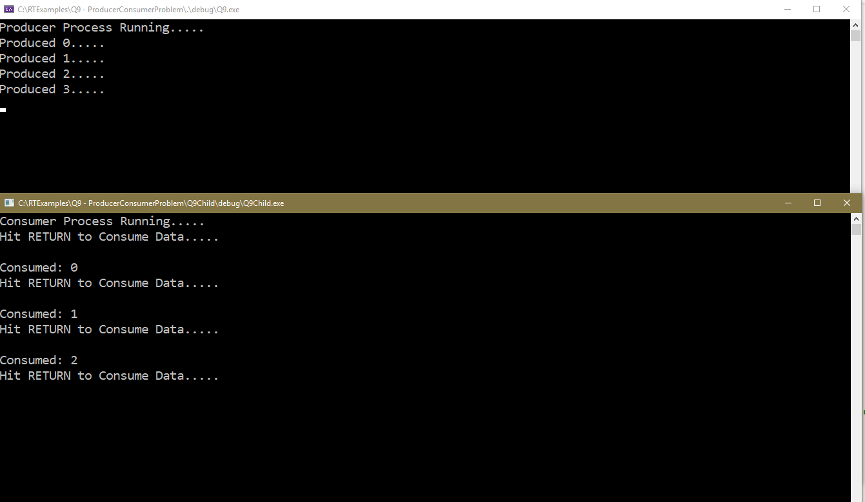
Q9 – Single Producer/Single Consumer problem. In this case consumer controls rate of production of data as it needs a key press from user each time in order to consume. Producer wakes up with each consume

Slide 14
More Problems - One Producer, Several Consumers
Consider the arrangement below, where we have one producer, P1 and several consumers, C1 and C2, communicating via the data pool DP1.
P1 must wait until C1 and C2 have both consumed the data in the data pool before it attempts to produce data again.
C1 and C2 must both wait for the producer to generate data.
The solution involves the use of two pairs of producer and consumer semaphores, as shown below.
P1
Signal()
Signal()
PS1=0
Wait()
PS2=0
Wait()
CS1=1
Produce
CS2=1
Wait()
Wait()
Signal()
Signal()
C1
Data Pool DP1
C2
Consume
Consume

Slide 15
Solution to One Producer, Several Consumers
The code inside the “forever” loop of each consumer and the single producer is shown below. This can be logically and simply extended to include any number of consumer threads.
Producer thread
Consumer 2 CS1.Wait() Consumer 1
PS2.Wait() CS2.Wait() PS1.Wait( )
Read_DP1() Update_DP1() Read_DP1()
CS2.Signal() PS1.Signal() CS1.Signal()
PS2.Signal()
From the point of view of each consumer, it appears to be synchronising itself to just a single producer as before.
In the case of the producer, it has to wait for both consumers to consume their data (the order in which it waits for each consumer does not matter).
Finally is can update the data pool as before, signalling both consumer semaphores (again the order of the signals does not matter).

Slide 16
More Producer Consumer Problems - Multiple Producers, One Consumer
Here we have two independent producers generating data which they place into two separate data pools for consumption by the single consumer. How does the consumer know which producer thread to wait for first?
Solution 1 - Polling
The consumer thread could poll each producer semaphore, using read() to see if either producer thread has produced data.
Note a producer thread will have produced when it’s PS_{n} semaphore is set to 1.
P1
P2
Wait()
Wait()
Signal()
CS1=1
CS2=1
Signal()
Signal()
Signal()
Produce
PS1=0
PS2=0
Produce
C1
Read() & Wait()
Read() & Wait()
Consume
Consume
Data Pool
DP1
Data Pool
DP2

Slide 17
Solution 1: Using polling
  Producer thread1 Consumer thread
  CS1.Wait() while( 1 ) {
  UpdatePool1() if( PS1.Read() > 0)
  PS1.Signal() ConsumeDatapool1()
  . . .
  . . .
  if( PS2.Read() > 0)
  ConsumeDatapool2()
  }
Note: In the functions ConsumeDatapool1() and ConsumeDatapool2() given for the consumer thread above, it will be necessary for the consumer to execute a WAIT() and SIGNAL() with the appropriate semaphores to ensure correct handshaking between producer and consumer) e.g.
  ConsumeDatapool1() { ConsumeDatapool2() {
  PS1.Wait() PS2.Wait()
  read_data_in_pool1 read_data_in_pool2
  CS1.Signal() CS2.Signal()
  } }
Inefficient due to polling
  Producer thread2
  CS2.Wait()
  UpdatePool2()
  PS2.Signal()

Slide 18
Solution 2 – Create Multiple Threads within the Consumer
Here the consumer thread is broken down into ‘n’ child threads to interact with the ‘n’ producer threads, one-to-one (just like we did for pipelines in an earlier lecture)
Each consumer thread now only has to perform Wait() and Signal() with one producer thread and thus the consumer thread code is the same as for a single producer/single consumer arrangement.
P1
P2
Wait()
Wait()
Signal()
CS1=1
CS2=1
Signal()
Signal()
Signal()
Produce
PS1=0
PS2=0
Produce
C1
Wait()
Wait()
Consume
Consume
Data Pool
DP1
Data Pool
DP2

Slide 19
Real Examples

Slide 20
Problem 1
Remember the b² – 4AC problem we discussed earlier in the course
  1st thread produces b²
  2nd thread produces 4AC
  3rd thread consumes both results and produces result of subtraction ‘-’
  We want the 2 threads to produce and 1 to consume at the same rate.
b
a
T1
T2
Wait()
Wait()
c
Signal()
CS1=1
CS2=1
Signal()
Signal()
Signal()
Produce
PS1=0
PS2=0
Produce
T3
Wait()
Wait()
Consume
Consume
Thread
Sharable
Variable b_sqr
Thread
Sharable
Variable 4ac
b² – 4ac

Slide 21
Solution 1
  Producer thread T1 Consumer thread T3
  CS1.Wait() while( 1 ) {
  Generate b_sqr PS1.Wait()
  PS1.Signal() PS2.Wait()
  result = b_sqr – 4ac
  CS1.Signal()
  CS2.Signal()
  }
  Producer thread T2 CS2.Wait()
  Generate 4ac
  PS2.Signal()

Slide 22
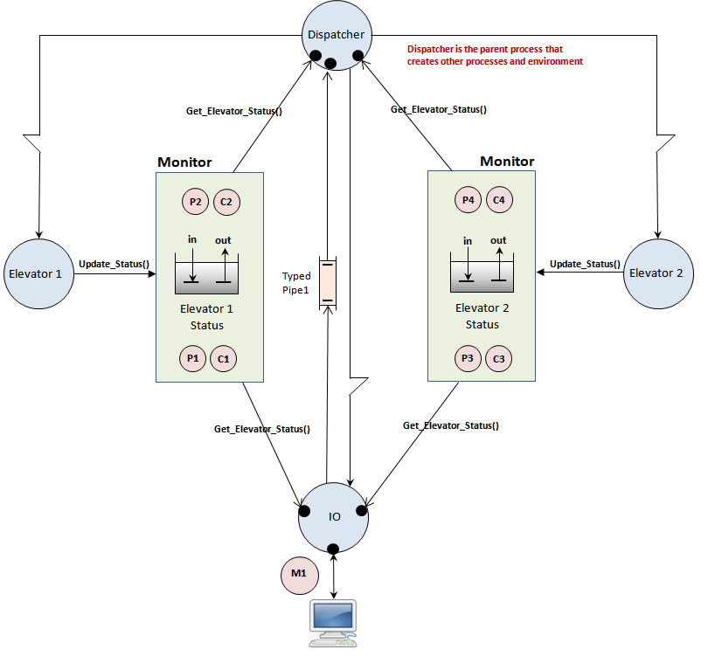
Assignment 1 - Producer Consumer Arrangement in an Elevator Simulation
Assignment 1
Think about each process shown here and decide if it is a producer or consumer of data
Think about how many other producers and consumers it has to synchronise itself to.
Lastly identify which of the previous Producer/Consumer arrangements would suit that process best.

Slide 23
Counting Semaphores

Slide 24
More General Non-Sharable Resources
Solving mutual exclusion and simple producer/consumer problems is only one application for a semaphore. Let's consider another problem.
Suppose we have a resource which is not entirely mutually exclusive, i.e. more than 1 is allowed to share it, but the is an upper limit to how many processes or threads can access it at the same time.
Examples in the Real World.
  A Football stadium with a 70,000 crowd capacity
  A Rollercoaster that can hold 30 passengers
  A Post-office or bank with say 6 counters.
  A Gas station with 4 pumps
  A Car Park with 20 spaces
How, for example, do you ensure that only 30 passengers get on a rollercoaster and that everybody gets off before you let the next 30 on.
How do we use semaphores to implement this?

Slide 25
The solution to this kind of mutual exclusion lies with a counting semaphore which implements a more general ‘counting gate’ concept allowing ‘n’ threads to pass through the gate and access the resource before forcing others to wait.
To create a counting semaphore only requires that we create a CSemaphore object with the initial and maximum count value specified, as shown below. In this example it has been written to have an initial and a maximum value of 6
The reason you get to specify both an initial and a maximum value is that there are some situations where they need to be different. For example you might want to create the semaphore with an initial value of 0 (to block all threads at the start), but allow the semaphore to count up to some max value using Signal() operations.
If you attempt to exceed the semaphores maximum value with too many Signal() operations, you will get a run-time error that you need to debug.
CSemaphore s("counter", 6, 6 ) ;
The name of the semaphore
The initial value of the semaphore
The initial value of the semaphore
The Maximum value of the semaphore

Slide 26
Rollercoaster Problem
Design the synchronisation mechanism for multiple passenger threads plus a rollercoaster thread such that
  Only 2 passengers can board the rollercoaster at a time i.e. they wait their turn.
  The rollercoaster will wait until 2 passengers have boarded before leaving.
  Each passenger will wait until they have ridden the rollercoaster before leaving.
  New passengers will wait until the current ride has finished and the 2 previous passengers have got off, before attempting to board.

Slide 27
Rollercoaster Solution : The Synchronisation Requirements and the Solution
Ensure only 2 passengers can board the rollercoaster at a time.
  Solution:
  Create a counting semaphore called "EntryGate" to act as a gate/turnstile.
  Initialise it to 0 so that initially no passengers can board.
  Passengers perform a Wait() on "EntryGate" before boarding the rollercoaster.
  Rollercoaster can Signal() "EntryGate" twice to allow 2 waiting passengers to board.
Rollercoaster must wait until 2 new passengers are Seated before leaving.
  Solution:
  Create a counting semaphore called "Full”.
  Initialise it to 0.
  The rollercoaster must perform 2 Wait() operations on this semaphore before departing for a ride to ensure it is full.
  Each passenger who boards the rollercoaster Signals() this semaphore.

Slide 28
A Passenger must wait until their ride is complete before getting off.
  Solution:
  Put a counting semaphore called "ExitGate" in place.
  Initialise with value 0.
  Passengers will perform a Wait() on "ExitGate" before attempting to get off.
  When the rollercoaster returns after a ride, it will Signal() this semaphore twice to let off the passengers.
New passengers must wait until the 2 previous passengers have got off, before boarding.
  Solution:
  Put a counting semaphore called "Empty" in place.
  Initialise with value 0.
  Passengers will perform a Signal() on "Empty" when they get off.
  The rollercoaster will perform a Wait() on "Empty" twice to ensure that the passengers have left before letting new passengers on (step 1)

Slide 29

CSemaphore EntryGate ("EntryGate", 0, 2)
CSemaphore ExitGate ("ExitGate", 0, 2)
Rollercoaster thread with 2 seats
Multiple "Charlie Brown" Threads trying to ride on the roller coaster
Entry Gate
Exit Gate
CSemaphore Empty ("Empty", 0, 2)
CSemaphore Full ("Full", 0, 2)
Each Charlie thread does this
EntryGate.Wait(); // wait to get on
Full.Signal() ; // indicate seat taken
// roller coaster goes for a ride here
ExitGate.Wait() ; // wait to get off
Empty.Signal(); // signal seat free
Rollercoaster thread does this
EntryGate.Signal() ; // lets in 1st Charlie
EntryGate.Signal() ; // lets in 2nd Charlie
Full.Wait() ; // wait for 1st Charlie to seat
Full.Wait() ; // wait for 2nd Charlie to seat
// rollercoaster goes for a ride here
ExitGate.Signal() ; // let 1st Charlie leave
ExitGate.Signal() ; // let 2nd Charlie leave
Empty.Wait() ; // wait for 1st Charlie to leave
Empty.Wait() ; // wait for 2nd Charlie to leave

Slide 30
Roller Coaster
Decremented
Unchanged as a “Charlie” is waiting
Incremented
Entry=1
Entry=0
Entry=2
Wait()
Exit=0
“Charlie" Blocked Trying to Get On
Charlie Blocked Trying to Get On
Wait()
Wait()
Charlie Blocked Trying to Get Off
Charlie Free to get off
Signal()
Wait()
Signal()
Signal()
Charlie 1 thread does this
EntryGate.Wait(); // wait to get on
Full.Signal() ; // indicate seat taken
// roller coaster goes for a ride here
ExitGate.Wait() ; // wait to get off
Empty.Signal(); // signal seat free
Wait()
Signal()
Wait()
Full=0
Empty=0
Decremented
Empty=2
Empty=1
Signal()
Incremented
Coaster Free to Ride
Rollercoaster thread does this
EntryGate.Signal() ; // lets in 1st Charlie
EntryGate.Signal() ; // lets in 2nd Charlie
Full.Wait() ; // waits for 1st Charlie
Full.Wait() ; // waits for 2nd Charlie
// rollercoaster goes for a ride
ExitGate.Signal() ; // let 1st Charlie leave
ExitGate.Signal() ; // let 2nd Charlie leave
Empty.Wait() ; // check 1st Charlie left
Empty.Wait() ; // check 2nd Charlie left
Charlie 2 thread does this
EntryGate.Wait(); // wait to get on
Full.Signal() ; // indicate seat taken
// roller coaster goes for a ride here
ExitGate.Wait() ; // wait to get off
Empty.Signal(); // signal seat free
Coaster Blocked trying to Ride
Unchanged as Coaster is waiting

Slide 31
Problem to think about
The previous solution was very strict. For example, the rollercoaster was not allowed to go for the ride until exactly 2 passengers had boarded. What if 1 passenger had boarded but there were no other waiting passengers.
It would be undesirable to make the one sitting passenger wait too long before satisfying their need to go for a ride (they would get bored and want their money back). Could you modify the rollercoaster code so that it went for a ride provided at least 1 passenger had boarded and that passenger had been kept waiting for at least 60secs.
Hint: take a look inside the RT Library and look up the wait() function for the CSemaphore class – the answer lies there.

